Slide 1
Configuration Guide
(Framework - Anyframe 3.1.0)
2009. 01. 08
CODELABOR
Shin Sang Jae (codelabor@gmail.com)

Slide 2
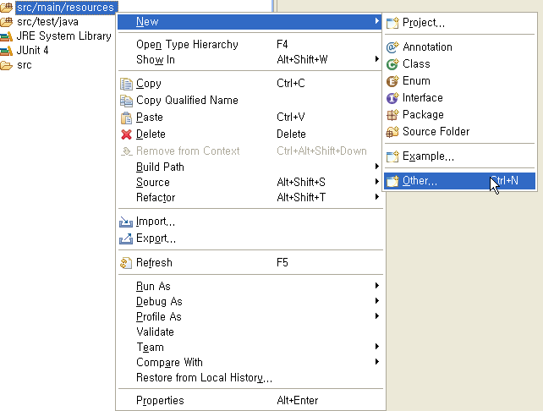
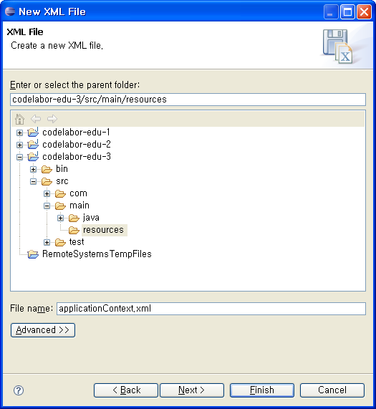
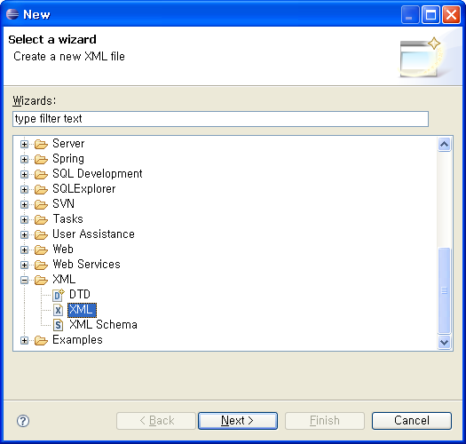
Application Context
Create File
Select Source Directory
Context Menu: New > Other > XML
File Name: applicationContext.xml

Slide 3
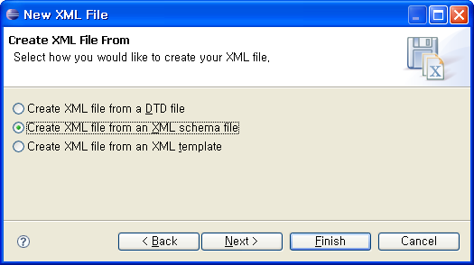
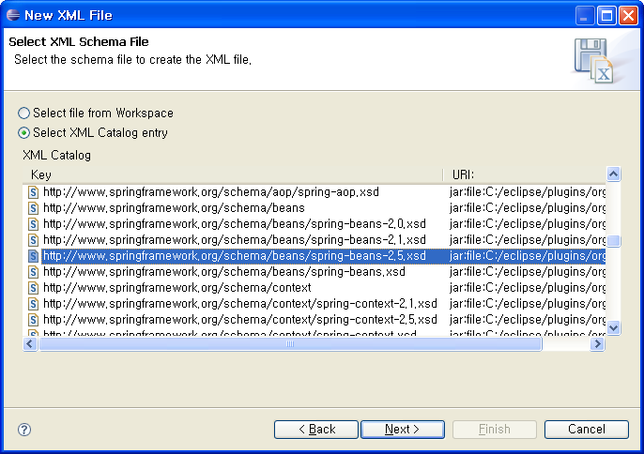
Application Context
Create File
Create XML file from an XML schema file
Select XML Catalog entry: http://www.springframework.org/schema/beans/spring-beans-2.5.xsd ...

Slide 4
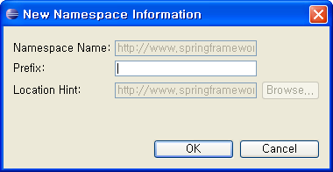
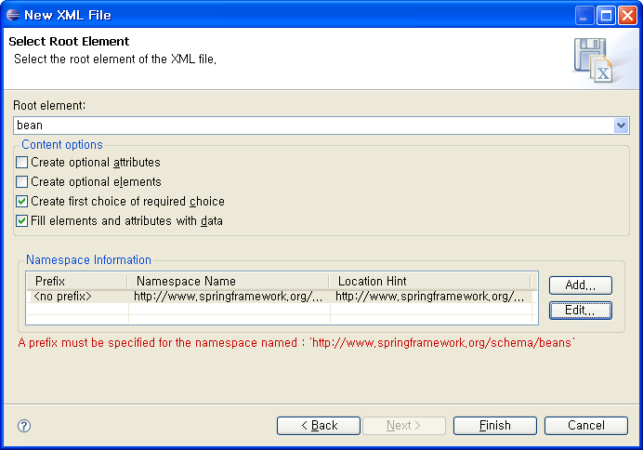
Application Context
Create File
Root element: bean
Namespace Information > Prefix: no prefix

Slide 5
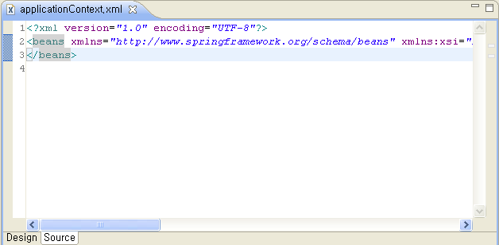
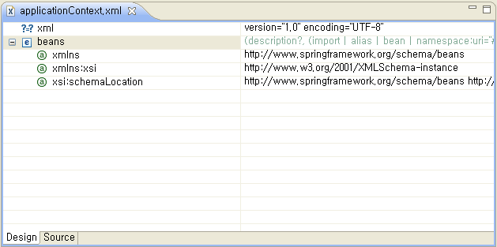
Application Context
Create File
Blank File

Slide 6
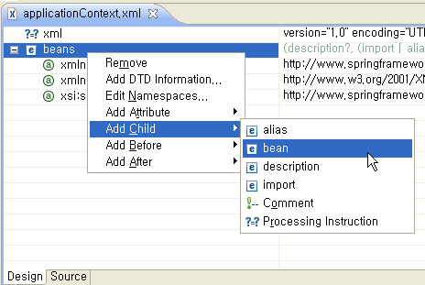
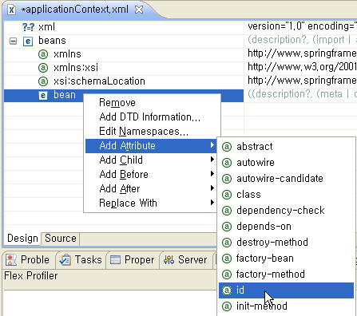
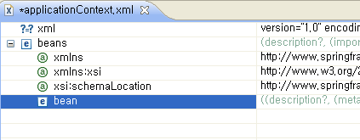
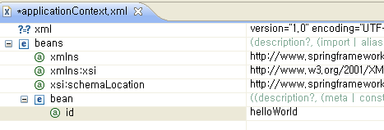
Application Context
Create File
Bean ID: helloWorld

Slide 7
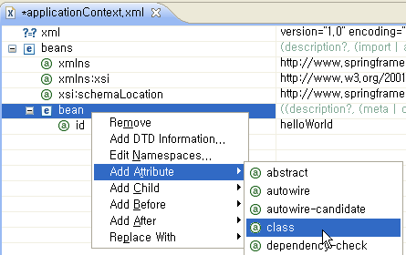
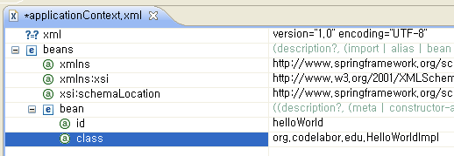
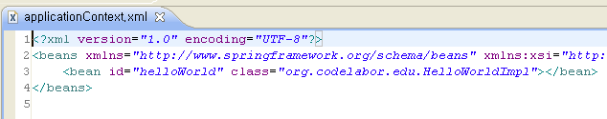
Application Context
Configuration
Bean ID: helloWorld

